Slide 1

Talent Acquisition Trends for 2026
Emerging strategies shaping the future of hiring
Notes:
---

Slide 2
Overview of 2026 Hiring Landscape
Notes:
---
This slide references information from the following file: https://brainsource.io/10-hiring-trends-that-will-define-2026/,https://www.flockity.com/brand-blog/talent-acquisition-in-2026-the-trends-you-cant-afford-to-ignore,https://www.shrm.org/content/dam/en/shrm/events/talent-2026-tracks.pdf
Introduction to 2026 Hiring Landscape

Slide 3

Introduction to 2026 Hiring Landscape
Technological Advancements
  AI-powered tools streamline sourcing, screening, and onboarding for efficient and personalized recruitment.
Remote and Hybrid Work
  Remote and hybrid models expand talent pools beyond geographic boundaries, increasing competition.
Skills-First Hiring
  Focus on relevant skills over formal education democratizes access to job opportunities.
Strategic Workforce Planning
  Ethical AI and strategic planning ensure resilience amid economic uncertainties and digital disruption.
Notes:
---
This slide references information from the following file: https://brainsource.io/10-hiring-trends-that-will-define-2026/,https://www.flockity.com/brand-blog/talent-acquisition-in-2026-the-trends-you-cant-afford-to-ignore,https://www.shrm.org/content/dam/en/shrm/events/talent-2026-tracks.pdf
The hiring landscape in 2026 is undergoing a profound transformation driven by technological advancements, evolving candidate expectations, and global workforce shifts. Traditional recruitment methods are being replaced by more agile, data-driven approaches that prioritize personalization, efficiency, and inclusivity. Organizations are increasingly adopting AI-powered tools to streamline sourcing, screening, and onboarding processes, while candidates expect seamless and engaging experiences throughout their journey. The rise of remote and hybrid work models has expanded talent pools beyond geographic boundaries, intensifying competition and necessitating new strategies for talent attraction and retention. Additionally, the emphasis on skills-first hiring is democratizing access to opportunities, allowing employers to tap into diverse talent with relevant competencies rather than relying solely on formal education credentials. As businesses navigate economic uncertainties and rapid digital disruption, strategic workforce planning and ethical AI implementation are becoming critical to maintaining resilience and achieving long-term success.

Slide 4
Technological Advancements in Recruitment
Notes:
---
This slide references information from the following file: https://www.hrtechnewsroom.com/blogs/hr-future-of-ai-and-recruitment-technologies-what-to-expect-by-2026/,https://explodingtopics.com/blog/ai-human-resources-trends,https://www.forbes.com/sites/keithferrazzi/2025/03/27/the-ai-recruitment-takeover-redefining-hiring-in-the-digital-age/
AI-Driven Recruitment, Predictive Analytics and Data-Driven Hiring

Slide 5
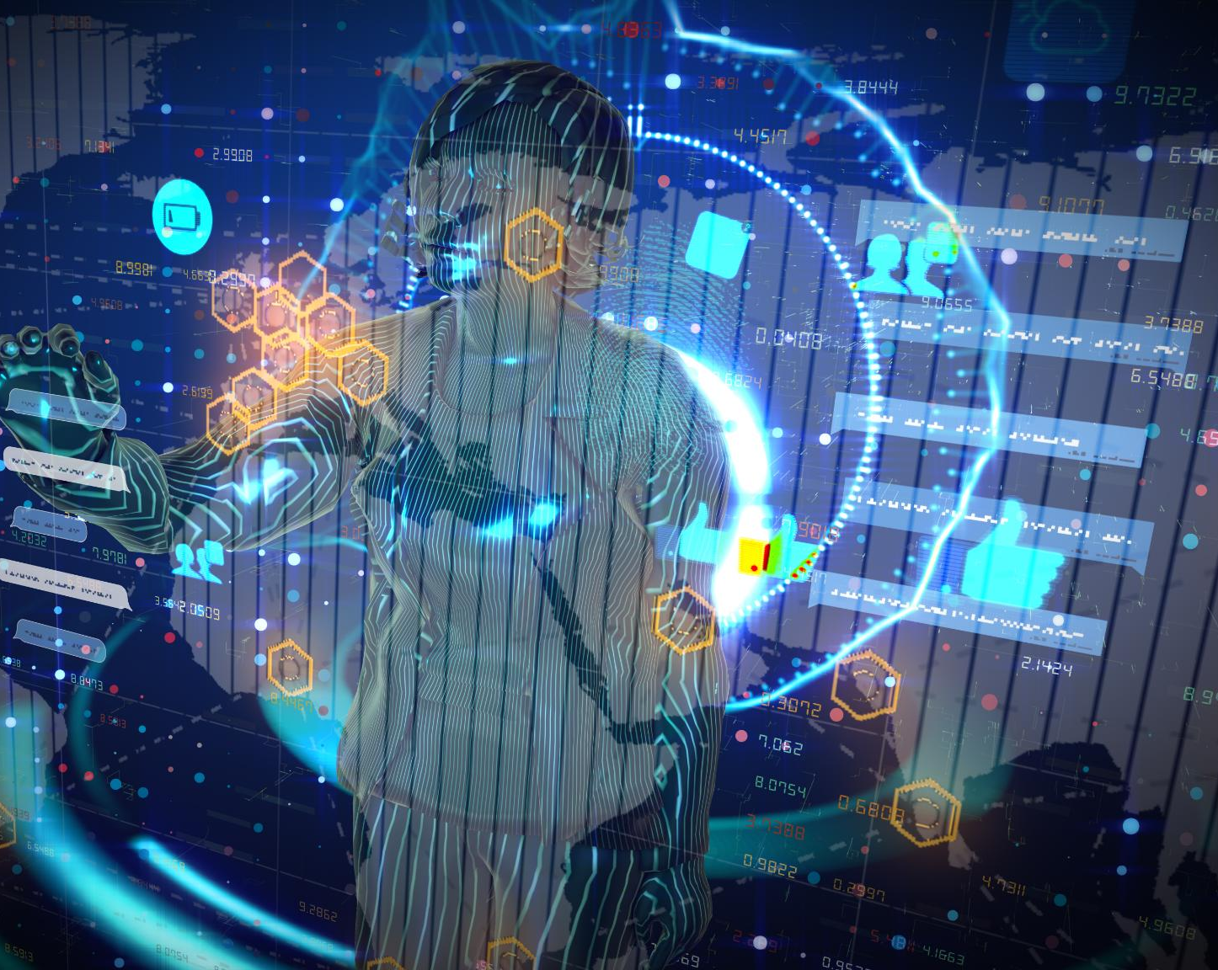
AI-Driven Recruitment
AI Automation in Hiring
  AI automates candidate sourcing, screening, and engagement, increasing recruitment efficiency and accuracy.
Virtual Hiring Assistants
  Virtual assistants provide real-time application guidance and personalized candidate support.
Predictive Analytics Benefits
  Predictive analytics forecast candidate retention and performance, supporting better hiring decisions.
Ethical AI in Recruitment
  Ethical AI use ensures transparency, fairness, and reduces bias to promote diversity and inclusion.
Notes:
---
This slide references information from the following file: https://www.hrtechnewsroom.com/blogs/hr-future-of-ai-and-recruitment-technologies-what-to-expect-by-2026/,https://explodingtopics.com/blog/ai-human-resources-trends,https://www.forbes.com/sites/keithferrazzi/2025/03/27/the-ai-recruitment-takeover-redefining-hiring-in-the-digital-age/
Artificial Intelligence (AI) is revolutionizing recruitment by automating and enhancing various stages of the hiring process. In 2026, AI tools are expected to dominate candidate sourcing, screening, and engagement. These tools utilize machine learning algorithms and natural language processing to analyze resumes, predict candidate success, and personalize outreach based on individual career trajectories and preferences. Virtual hiring assistants guide candidates through applications, providing real-time feedback and support. Predictive analytics help recruiters forecast retention and performance, enabling more informed decision-making. The integration of AI not only improves efficiency but also reduces unconscious bias, promoting diversity and inclusion. However, ethical considerations remain paramount, as organizations must ensure transparency, fairness, and compliance in AI deployment. The widespread adoption of AI in recruitment is reshaping the role of human recruiters, allowing them to focus on strategic tasks and relationship-building while leveraging technology for operational excellence.

Slide 6

Predictive Analytics and Data-Driven Hiring
KPIs in Recruitment
  Recruitment relies on KPIs like time-to-hire, cost-per-hire, quality-of-hire, and retention to measure success.
Advanced HR Tech Tools
  Integrated HR tech stacks offer real-time insights into hiring bottlenecks and return on investment.
Predictive Hiring Models
  Predictive models analyze data to identify candidates with high potential for success and retention.
Data-Driven Hiring Culture
  Data-driven hiring encourages accountability, continuous improvement, and enhanced workforce performance.
Notes:
---
This slide references information from the following file: https://www.hrtechnewsroom.com/blogs/hr-future-of-ai-and-recruitment-technologies-what-to-expect-by-2026/,https://explodingtopics.com/blog/ai-human-resources-trends,https://www.forbes.com/sites/keithferrazzi/2025/03/27/the-ai-recruitment-takeover-redefining-hiring-in-the-digital-age/
Predictive analytics and data-driven hiring are becoming standard practices in talent acquisition. By 2026, recruitment leaders are expected to rely heavily on key performance indicators (KPIs) such as time-to-hire, cost-per-hire, quality-of-hire, and retention metrics. Advanced dashboards and integrated HR tech stacks provide real-time insights into hiring bottlenecks and return on investment. These tools enable proactive workforce planning, allowing organizations to anticipate talent needs and align hiring strategies with business objectives. Predictive models analyze historical data and behavioral patterns to identify candidates with the highest potential for success and longevity. This approach minimizes the risk of poor hires and enhances overall workforce performance. As data becomes central to recruitment decisions, HR professionals must develop analytical competencies and ensure data integrity and privacy. The shift towards data-driven hiring marks a significant departure from intuition-based practices, fostering a culture of accountability and continuous improvement.

Slide 7
Evolving Hiring Models
Notes:
---
This slide references information from the following file: https://brainsource.io/10-hiring-trends-that-will-define-2026/,https://empxtrack.com/blog/recent-hr-trends-2026/,https://gfoundry.com/hr-trends-what-will-hr-look-like-in-2026/
Skills-First Hiring, Remote and Hybrid Work Models

Slide 8
Skills-First Hiring
Hiring Method | Effectiveness Score
Degree-Based | 70
Skills-Based | 90
Notes:
---
This slide references information from the following file: https://brainsource.io/10-hiring-trends-that-will-define-2026/,https://empxtrack.com/blog/recent-hr-trends-2026/,https://gfoundry.com/hr-trends-what-will-hr-look-like-in-2026/
Skills-first hiring is emerging as a dominant paradigm in 2026, shifting the focus from traditional degree-based qualifications to demonstrable competencies. Leading organizations like Google and IBM have already embraced this approach, recognizing that skills are more indicative of job performance than formal education. Micro-credentials, certifications, and portfolio-based assessments are replacing diplomas, enabling candidates to showcase their abilities through tangible outputs such as GitHub repositories, case studies, and design portfolios. AI-driven assessment platforms evaluate technical and soft skills, ensuring objective and comprehensive candidate evaluations. This trend democratizes access to employment, broadens the talent pool, and aligns hiring practices with dynamic business needs. Employers benefit from faster onboarding and reduced training costs, while candidates gain opportunities based on merit and potential. As skills-based hiring becomes the norm, HR teams must adapt job descriptions, evaluation criteria, and career development frameworks to support this inclusive and future-ready model.

Slide 9
Remote and Hybrid Work Models
Work Model | Preference (%)
Fully Remote | 26
Hybrid | 48
On-site | 26
Notes:
---
This slide references information from the following file: https://brainsource.io/10-hiring-trends-that-will-define-2026/,https://empxtrack.com/blog/recent-hr-trends-2026/,https://gfoundry.com/hr-trends-what-will-hr-look-like-in-2026/
Remote and hybrid work models have become integral to modern talent acquisition strategies. The pandemic accelerated the adoption of flexible work arrangements, and by 2026, these models are firmly entrenched across industries. Remote work expands access to global talent, enabling organizations to source candidates from diverse geographic locations. Hybrid models offer a balance between in-person collaboration and remote flexibility, catering to varied employee preferences. Data indicates that 48% of job seekers prefer hybrid roles, while 26% favor fully remote positions. This shift necessitates changes in recruitment messaging, onboarding processes, and performance management. Employers must invest in digital collaboration tools, virtual engagement platforms, and inclusive policies to support distributed teams. Additionally, remote work influences compensation structures, compliance requirements, and cultural integration. As competition for remote talent intensifies, companies must differentiate themselves through strong employer branding, transparent communication, and meaningful employee experiences.

Slide 10
Innovative Talent Attraction Strategies
Notes:
---
This slide references information from the following file: https://www.flockity.com/brand-blog/talent-acquisition-in-2026-the-trends-you-cant-afford-to-ignore,https://www.dover.com/blog/startup-hiring-trends-2026
Creator-Led and Influencer Recruiting

Slide 11

Creator-Led and Influencer Recruiting
Rise of Creator Recruiting
  Creator-led recruiting uses trusted voices to genuinely connect with passive candidates and attract talent effectively.
Multi-Channel Engagement
  Companies leverage social media, podcasts, and communities to promote job opportunities and increase candidate reach.
Trust and Authenticity
  Candidates prefer real-life testimonials and peer recommendations over polished corporate campaigns for employer branding.
Measuring Success
  Employers track engagement metrics and application rates to evaluate the impact of creator-led recruitment strategies.
Notes:
---
This slide references information from the following file: https://www.flockity.com/brand-blog/talent-acquisition-in-2026-the-trends-you-cant-afford-to-ignore,https://www.dover.com/blog/startup-hiring-trends-2026
Creator-led and influencer recruiting is gaining traction as a powerful method for talent attraction. Inspired by influencer marketing in consumer behavior, this approach leverages trusted voices to connect with passive candidates authentically. By 2026, companies are expected to partner with content creators, industry experts, and employee advocates to promote job opportunities through social media, podcasts, and community platforms. This strategy enhances reach, engagement, and conversion without inflating recruitment budgets. Candidates are increasingly influenced by peer recommendations and real-life testimonials rather than polished corporate campaigns. Trust and authenticity are the new currency in employer branding. Organizations that embrace creator-led recruiting can build stronger connections with talent, foster brand loyalty, and differentiate themselves in a crowded market. To succeed, employers must identify relevant creators, co-create compelling content, and measure impact through engagement metrics and application rates.

Slide 12
Strategic and Ethical Considerations
Notes:
---
This slide references information from the following file: https://www.shrm.org/executive-network/insights/the-impact-of-ai-on-talent-acquisition-and-recruitment,https://www.gartner.com/en/human-resources/topics/artificial-intelligence-in-hr
Ethical AI and Bias Reduction, Workforce Planning Strategies

Slide 13

Ethical AI and Bias Reduction
AI Bias and Risks
  Improperly designed AI can perpetuate biases, causing unfair and discriminatory hiring outcomes.
Governance and Regulation
  Organizations must implement governance frameworks and comply with legal requirements to mitigate AI bias.
Human Oversight and Training
  Balancing automation with human judgment and training HR in ethical AI ensures responsible recruitment innovation.
Benefits of Ethical AI
  Ethical AI builds trust, improves reputation, and promotes diversity and inclusion in hiring processes.
Notes:
---
This slide references information from the following file: https://www.shrm.org/executive-network/insights/the-impact-of-ai-on-talent-acquisition-and-recruitment,https://www.gartner.com/en/human-resources/topics/artificial-intelligence-in-hr
As AI becomes central to recruitment, ethical considerations are paramount. AI algorithms, if not properly designed and monitored, can perpetuate or amplify biases, leading to discriminatory hiring practices. In 2026, organizations are expected to implement robust governance frameworks to ensure fairness, transparency, and accountability in AI deployment. This includes auditing algorithms, diversifying training datasets, and involving cross-functional teams in tool selection and evaluation. Regulatory bodies may also impose legal requirements for bias mitigation and ethical compliance. Ethical AI fosters trust among candidates, enhances employer reputation, and supports diversity and inclusion goals. Companies must balance automation with human oversight, ensuring that technology complements rather than replaces human judgment. Training HR professionals in ethical AI usage and establishing clear policies are essential steps toward responsible innovation. By prioritizing ethics, organizations can harness AI's benefits while safeguarding candidate rights and promoting equitable hiring outcomes.

Slide 14

Workforce Planning Strategies
Future Skill Anticipation
  Organizations must anticipate future skill needs by analyzing labor trends and forecasting talent gaps.
Agile Hiring Models
  Developing agile hiring models enables responsive talent acquisition aligned with business goals.
AI and Analytics Role
  AI and advanced analytics enhance planning accuracy and enable real-time talent management decisions.
Employee Expectations
  Effective workforce planning addresses flexibility, growth, and well-being to improve retention and productivity.
Notes:
---
This slide references information from the following file: https://www.shrm.org/executive-network/insights/the-impact-of-ai-on-talent-acquisition-and-recruitment,https://www.gartner.com/en/human-resources/topics/artificial-intelligence-in-hr
Strategic workforce planning is critical for navigating the complexities of the 2026 talent landscape. Organizations must anticipate future skill requirements, align talent acquisition with business objectives, and build resilient workforce ecosystems. This involves analyzing labor market trends, forecasting talent gaps, and developing agile hiring models. AI and advanced analytics play a pivotal role in enhancing planning accuracy and responsiveness. Companies are moving away from static org charts and annual planning cycles toward dynamic, real-time talent operating models. These models integrate skill visibility, internal mobility, and just-in-time deployment to optimize workforce utilization. Additionally, workforce planning must address employee expectations for flexibility, growth, and well-being. HR leaders must collaborate with business units, leverage technology, and foster a culture of continuous learning and adaptability. Effective planning reduces turnover, improves productivity, and positions organizations for sustainable success in a rapidly changing environment.

Slide 15
Conclusion and Recommendations
Notes:
---
This slide references information from the following file: https://brainsource.io/10-hiring-trends-that-will-define-2026/,https://www.shrm.org/content/dam/en/shrm/events/talent-2026-tracks.pdf,https://www.deloitte.com/us/en/services/consulting/blogs/human-capital/talent-acquisition-technology-trends.html
Summary and Strategic Recommendations

Slide 16
Summary and Strategic Recommendations
Tool | Adoption Rate (%)
Resume Screening | 85
Candidate Matching | 78
Interview Analysis | 65
Onboarding Automation | 72
Notes:
---
This slide references information from the following file: https://brainsource.io/10-hiring-trends-that-will-define-2026/,https://www.shrm.org/content/dam/en/shrm/events/talent-2026-tracks.pdf,https://www.deloitte.com/us/en/services/consulting/blogs/human-capital/talent-acquisition-technology-trends.html
The talent acquisition landscape in 2026 is defined by innovation, agility, and inclusivity. Key trends include AI-driven recruitment, skills-first hiring, remote work models, creator-led attraction strategies, and ethical AI implementation. Organizations must embrace these changes to remain competitive and attract top talent. Strategic recommendations include investing in AI and analytics, redesigning hiring processes to prioritize skills, leveraging authentic voices for employer branding, and developing robust workforce planning frameworks. Ethical considerations must guide technology adoption to ensure fairness and compliance. By aligning talent strategies with business goals and employee expectations, companies can build resilient, high-performing teams. Continuous learning, adaptability, and collaboration are essential for navigating the future of work. HR leaders must champion these initiatives, foster innovation, and create inclusive environments that empower individuals and drive organizational success.

