Slide 1

AI Strategy and Tools for Executive Recruiting
Enhancing recruitment efficiency with advanced AI technology
Notes:
---

Slide 2
AI Strategy and Tools for Executive Recruiting
Notes:
---
This slide references information from the following file: https://www.jrgpartners.com/ai-in-executive-headhunting-for-2025/,https://recruiterflow.com/blog/ai-for-executive-search/,https://pixcell.co/en/market-insights/how-ai-is-utilized-in-executive-recruitment/
Introduction to AI in Executive Recruiting, Benefits of AI in Executive Recruiting, Key AI Tools for Executive Recruiting, Case Studies and Examples, Challenges and Ethical Considerations, Future Trends in AI for Executive Recruiting, Summary and Recommendations

Slide 3
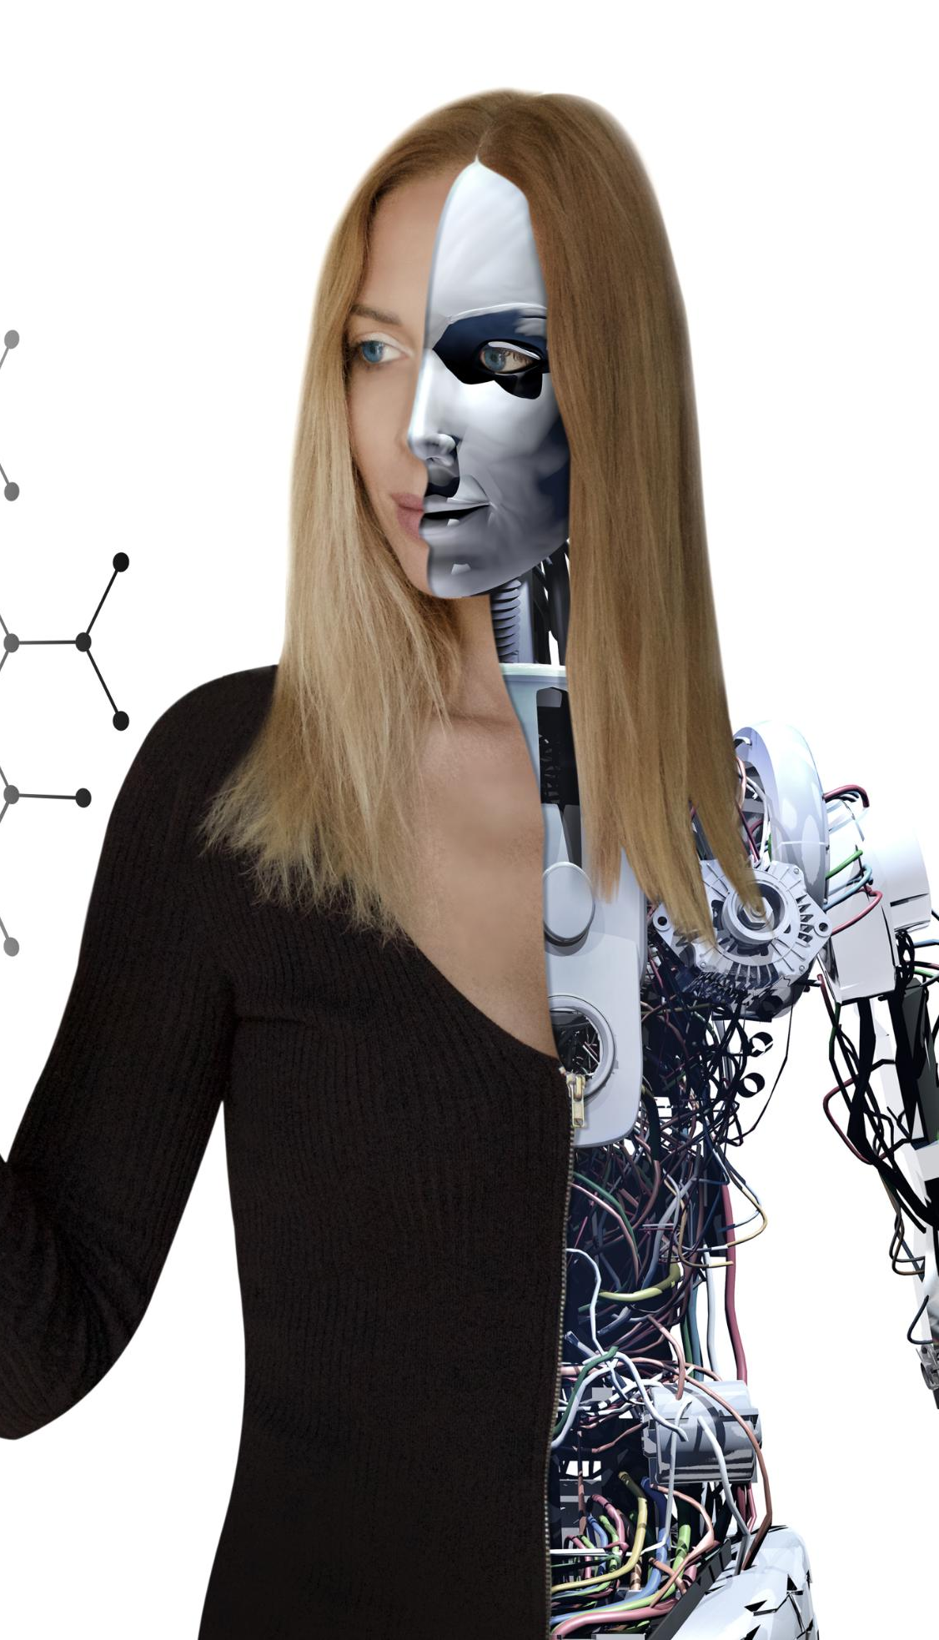
Introduction to AI in Executive Recruiting
Traditional Recruitment Challenges
  Manual methods like networking and referrals are time-consuming and limited in talent scope.
AI-Driven Talent Identification
  AI uses machine learning and natural language processing to analyze large datasets for candidate matching.
Broader Talent Access
  AI enables access to a wider talent pool, improving efficiency and decision-making speed.
Predictive Analytics in Hiring
  Predictive analytics forecast candidate success, enhancing precision in executive placements.
Notes:
---
This slide references information from the following file: https://www.jrgpartners.com/ai-in-executive-headhunting-for-2025/,https://recruiterflow.com/blog/ai-for-executive-search/,https://pixcell.co/en/market-insights/how-ai-is-utilized-in-executive-recruitment/
Artificial Intelligence (AI) is rapidly transforming the landscape of executive recruiting by automating and enhancing various aspects of the hiring process. Traditionally, executive recruitment relied heavily on manual processes such as personal networking, industry referrals, and extensive candidate evaluations. These methods, while effective, were time-consuming and limited in scope. With the integration of AI, recruiters can now leverage data-driven strategies to identify top leadership talent more efficiently. AI technologies such as machine learning and natural language processing enable the analysis of vast datasets, including resumes, professional profiles, and behavioral assessments, to identify candidates who best match the required skill sets and leadership qualities. This shift allows recruiters to access a broader talent pool and make more informed decisions in a fraction of the time. Moreover, AI enhances the precision of candidate matching by using predictive analytics to forecast long-term success within an organization. As executive recruiting continues to evolve, understanding the role of AI is essential for firms aiming to stay competitive and deliver high-quality placements.

Slide 4

Benefits of AI in Executive Recruiting
Automation of Screening Tasks
  AI automates resume screening and interview scheduling, saving recruiters significant time and effort.
Reduction of Hiring Bias
  AI uses structured assessments to minimize unconscious bias, promoting fairness in recruitment.
Predictive Analytics for Hiring
  AI predicts candidate success using historical data and behavioral patterns, improving hiring decisions.
Enhanced Recruiter Effectiveness
  AI empowers recruiters to focus on relationship-building by handling data-intensive tasks efficiently.
Notes:
---
This slide references information from the following file: https://www.jrgpartners.com/ai-in-executive-headhunting-for-2025/,https://recruiterflow.com/blog/ai-for-executive-search/,https://pixcell.co/en/market-insights/how-ai-is-utilized-in-executive-recruitment/
AI offers numerous benefits in executive recruiting, significantly improving efficiency, reducing bias, and enabling predictive analytics. One of the primary advantages is the automation of time-consuming tasks such as resume screening and interview scheduling. Machine learning algorithms can quickly analyze large volumes of data to identify candidates with the desired qualifications, drastically reducing the time spent on initial screenings. This allows recruiters to focus on engaging with candidates and building relationships. Another critical benefit is the reduction of unconscious bias in the hiring process. AI systems use structured, repeatable assessments and data-driven scoring to evaluate candidates, minimizing the influence of subjective opinions. This promotes a more inclusive and fair recruitment process. Additionally, AI enables predictive analytics, which helps organizations forecast a candidate’s potential success based on historical hiring data and behavioral patterns. These insights support better hiring decisions and reduce the risk of costly mis-hires. Overall, AI empowers recruiters with tools that enhance decision-making, improve candidate experience, and increase the overall effectiveness of executive search efforts.

Slide 5
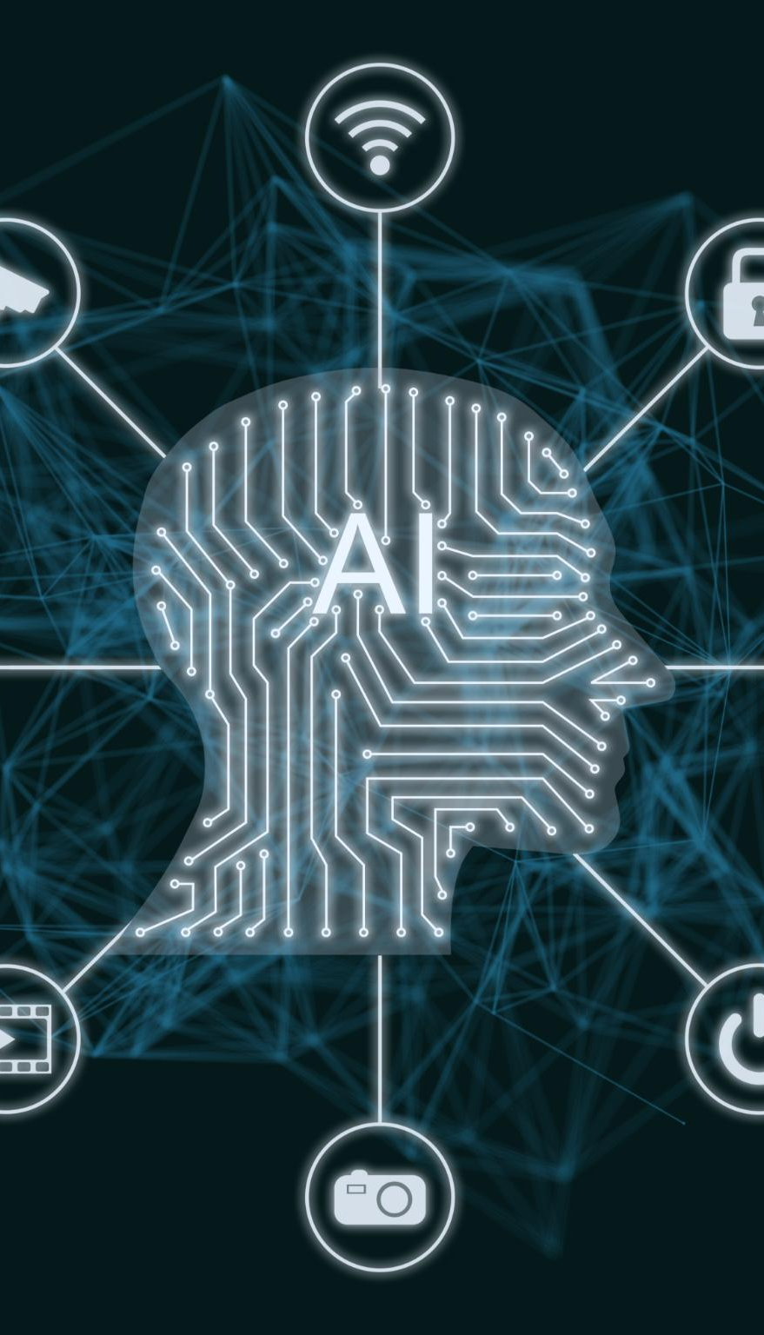
Key AI Tools for Executive Recruiting
AI-Powered Applicant Tracking
  AI-driven ATS use NLP to evaluate resumes based on leadership qualities and identify top candidates efficiently.
Predictive Analytics and Machine Learning
  Machine learning platforms analyze hiring data to predict candidate success and cultural fit for better hiring decisions.
AI Chatbots and Candidate Engagement
  AI chatbots provide instant, personalized communication to enhance candidate experience throughout the recruitment process.
Virtual Interviews and Online Assessments
  Virtual tools automate evaluations of personality, cognition, and situational judgment for comprehensive candidate insights.
Notes:
---
This slide references information from the following file: https://www.jrgpartners.com/ai-in-executive-headhunting-for-2025/,https://recruiterflow.com/blog/ai-for-executive-search/,https://pixcell.co/en/market-insights/how-ai-is-utilized-in-executive-recruitment/
Several AI tools are revolutionizing executive recruiting by streamlining various stages of the hiring process. Applicant Tracking Systems (ATS) powered by AI use natural language processing (NLP) to evaluate resumes against leadership-specific criteria, such as strategic vision and change management experience. These systems interpret resumes and cover letters to identify high-potential candidates. Machine learning platforms analyze historical hiring data and behavioral assessments to predict candidate success and cultural fit. Predictive analytics engines provide insights into long-term performance and retention probabilities. AI-powered chatbots enhance candidate engagement by providing instant responses and personalized communication throughout the recruitment journey. Additionally, virtual interview tools and online assessments automate personality, cognitive ability, and situational judgment evaluations, offering a comprehensive view of a candidate’s capabilities. These tools collectively improve sourcing accuracy, reduce time-to-hire, and support data-driven decision-making, making them indispensable in modern executive search practices.

Slide 6

Case Studies and Examples
Streamlined Resume Analysis
  AI helps reduce screening time by automating resume analysis, enabling recruiters to focus on candidate engagement.
Productivity Gains with AI
  Integration of AI in recruitment workflows can boost productivity by over 60%, enhancing recruiter efficiency.
Automation of Routine Tasks
  AI agents automate candidate monitoring, CRM updates, and follow-up communications, freeing recruiters from repetitive work.
Enhanced Recruitment Experience
  AI enables recruiters to spend more time in meaningful candidate conversations, improving client satisfaction.
Notes:
---
This slide references information from the following file: https://www.jrgpartners.com/ai-in-executive-headhunting-for-2025/,https://recruiterflow.com/blog/ai-for-executive-search/,https://pixcell.co/en/market-insights/how-ai-is-utilized-in-executive-recruitment/
Real-world examples illustrate the transformative impact of AI in executive recruiting. KIP Search, a leading executive search firm, utilizes AI to streamline resume analysis and reduce screening time, allowing recruiters to focus on deeper candidate engagement. Adecco, a global staffing firm, integrated AI into its recruiter workflows and achieved up to 63% productivity gains. Their Recruiter GenAI Suite enables recruiters to spend more time on meaningful conversations with candidates, enhancing the overall recruitment experience. Recruiterflow employs AI agents to automate candidate monitoring, CRM updates, and intelligent follow-up communications, freeing up recruiters from repetitive tasks. These case studies demonstrate how AI tools can significantly improve efficiency, accuracy, and client satisfaction in executive search. By leveraging AI, firms can deliver faster shortlists, smarter candidate insights, and maintain a high-touch, relationship-driven approach, positioning themselves as forward-thinking and agile partners in the recruitment industry.

Slide 7

Challenges and Ethical Considerations
Understanding Team Dynamics
  AI may overlook team dynamics and cultural fit due to reliance on quantifiable data, unlike human recruiters.
Bias and Fairness Risks
  AI can perpetuate biases if training data is not managed properly, requiring ethical oversight to ensure fairness.
Transparency and Accountability
  Transparent AI decision-making and human oversight are essential for building trust and maintaining accountability.
Data Privacy and Security
  Protecting data privacy and security is critical when implementing AI tools in executive recruiting.
Notes:
---
This slide references information from the following file: https://www.jrgpartners.com/ai-in-executive-headhunting-for-2025/,https://recruiterflow.com/blog/ai-for-executive-search/,https://pixcell.co/en/market-insights/how-ai-is-utilized-in-executive-recruitment/
Despite its benefits, the adoption of AI in executive recruiting presents several challenges and ethical considerations. One major concern is the lack of understanding of team dynamics and cultural fit, which AI systems may overlook due to their reliance on quantifiable data. Human recruiters possess the interpersonal skills and industry knowledge necessary to assess these nuanced aspects. Another challenge is the potential for AI to perpetuate existing biases if the training data is not properly managed. Algorithms can inadvertently amplify discriminatory practices, making ethical oversight crucial. Transparency in AI decision-making processes is essential to build trust and ensure fairness. Additionally, there is a need for human oversight to validate AI-generated recommendations and maintain accountability. Organizations must also consider data privacy and security when implementing AI tools. Addressing these challenges requires a balanced approach that combines technological innovation with ethical responsibility, ensuring that AI enhances rather than compromises the integrity of executive recruiting.

Slide 8
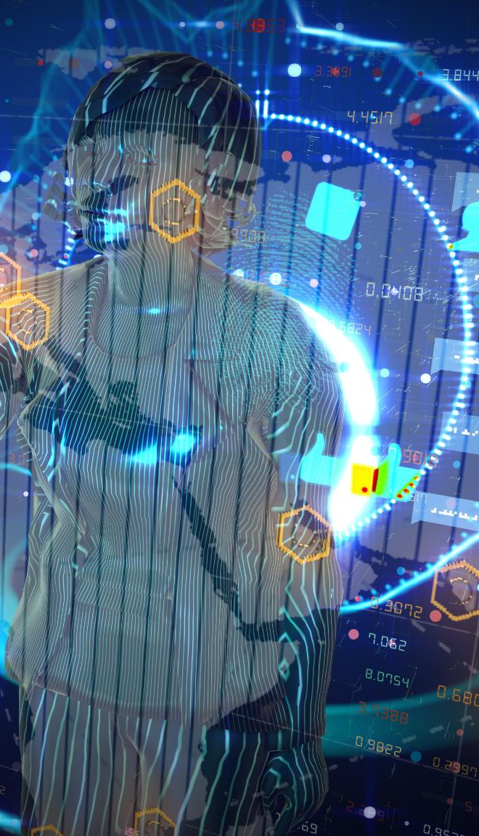
Future Trends in AI for Executive Recruiting
Autonomous AI Agents
  AI agents will proactively manage candidate monitoring, data updates, and intelligent outreach as digital teammates.
Advanced Predictive Modeling
  Predictive models will forecast long-term candidate success with increasing accuracy and sophistication.
Wearable Technology Integration
  AI integrated with wearable tech will provide real-time insights during candidate interactions.
Ethical and Inclusive AI
  Emphasis on transparency, fairness, and inclusive hiring practices in AI-driven recruiting processes.
Notes:
---
This slide references information from the following file: https://www.jrgpartners.com/ai-in-executive-headhunting-for-2025/,https://recruiterflow.com/blog/ai-for-executive-search/,https://pixcell.co/en/market-insights/how-ai-is-utilized-in-executive-recruitment/
The future of AI in executive recruiting is poised for significant advancements, with emerging trends indicating deeper integration and enhanced capabilities. One notable trend is the rise of autonomous AI agents that continuously learn from historical datasets and make proactive decisions. These agents act as digital teammates, handling tasks such as candidate monitoring, data updates, and intelligent outreach. Predictive modeling will become more sophisticated, enabling recruiters to forecast long-term candidate success with greater accuracy. Integration of AI with wearable technology may provide real-time insights during candidate interactions, further augmenting recruiter capabilities. Ethical AI and inclusive hiring practices will gain prominence, with firms prioritizing transparency and fairness in AI-driven processes. Additionally, AI will support the development of supermanagers—leaders who facilitate and coach AI use within their teams. As AI continues to evolve, executive search firms must stay informed and adapt to these trends to maintain a competitive edge and deliver superior recruitment outcomes.

Slide 9

Summary and Recommendations
AI Benefits in Recruiting
  AI improves recruitment efficiency, reduces bias, and supports data-driven hiring decisions for better candidate matches.
Challenges and Ethics
  Addressing team dynamics, ethical concerns, and data privacy is essential for responsible AI use in recruiting.
Future Trends
  Emerging trends like autonomous AI agents and wearable tech will further transform executive recruiting.
Recommendations
  Firms should blend AI tools with human judgment, ensure transparency, and foster innovation for success.
Notes:
---
This slide references information from the following file: https://www.jrgpartners.com/ai-in-executive-headhunting-for-2025/,https://recruiterflow.com/blog/ai-for-executive-search/,https://pixcell.co/en/market-insights/how-ai-is-utilized-in-executive-recruitment/
In summary, AI is revolutionizing executive recruiting by enhancing efficiency, reducing bias, and enabling data-driven decision-making. Key tools such as ATS, NLP, machine learning platforms, and predictive analytics engines streamline the recruitment process and improve candidate matching. Case studies from firms like KIP Search and Adecco highlight the tangible benefits of AI integration. However, challenges such as understanding team dynamics, ethical concerns, and data privacy must be addressed to ensure responsible AI use. Looking ahead, trends like autonomous AI agents and wearable tech integration will further transform the industry. To leverage AI effectively, executive search firms should use these tools to complement human judgment, maintain transparency, and prioritize ethical practices. Staying updated with evolving technologies and fostering a culture of innovation will be crucial for success in the AI-driven future of executive recruiting.

